Slide 1
We’ll begin shortly!

Slide 2
EDI Provider Lunch & Learn
Third-Party System Visit Import 101 and FAQs
Spring 2025
Notes:
Good Afternoon everyone, and thank you for joining us today. My name is Colby Ward, Director of Customer Success with HHAeXchange and today I will be hosting this Webinar to discuss the EDI Process. If you have questions during the webinar, please use the Q&A feature at the bottom of the window. We have a panel of team members here to answer your questions.

Slide 3
Acronyms
EVV: Electronic Visit Verification
HHCS: Home Health Care Services
EDI: Electronic Data Interchange (Alternate EVV)
API: Application Programming Interface
RIN: Recipient Identification Number
HFS: Health & Family Services
DDD: Division of Developmental Disabilities
DSCC: Division of Specialized Care for Children
Notes:
Before we get started, here is a list of acronyms you may hear during the presentation and what they mean.

Slide 4
Agenda
Utilize the Q&A box if you have any questions throughout today’s presentation.
Only questions about today’s presentation content will be answered.
If you have a specific question about your visits, please submit a support ticket.
Intro to EVV and EDI
Getting Started with HHAeXchange EDI
EVV Roles & Responsibilities
Managing Visit Import Rejections
Resources & Supports
Notes:
Today we will be going over the following topics, starting with an Intro to EVV and what EDI means, then we’ll talk about Getting Started with HHaeXchange as an EDI provider if you have not already gotten your integration started. After that, we’ll discuss what the roles are of the different stakeholders involved with successful data transmission. We’ll go over FAQs and Managing Visit import rejections and then finally we’ll cover some helpful resources. As mentioned before, please use the Q&A box if you have questions about the content of the presentation. If you have questions about your visits specifically, please submit a ticket to our Technical Customer Care team. There is information on how to do that at the end of this webinar.

Slide 5
Intro:
EVV & EDI
Notes:
Let’s start with an intro to EVV and EDI

Slide 6
The Basics
21st Century Cures Act
  Passed by Congress in December 2016, the 21st Century Cures Act requires that providers of Personal Care Services confirm visits via Electronic Visit Verification (EVV) by January 1, 2020, and Home Health Care Services (HHCS) by January 1, 2023. Illinois received a Good Faith Exemption and implemented EVV for HHCS on 12/31/23.
Electronic Visit Verification (EVV):
  Caregivers clock in and out of their visits using an electronic means (ex: Telephony or Mobile App). Six (6) key data elements are captured during clock in/out: Date of Visit, Time of Visit, Location of Visit, Client Receiving Services, Caregiver Providing Services, and Service Being Provided.
Electronic Data Interchange (EDI):
  HHAeXchange and your EVV System communicate electronically to share data back and forth. Your EVV System sends HHAeXchange Caregiver and Visit data, and HHAeXchange sends your EVV System responses (Success or Failure).
Notes:
Starting with the basics, what is EVV and why is it important.

Slide 7


Open Model: Provider Choice of EVV Vendor
OR
3rd Party EVV Vendor
Illinois is an open model state meaning that providers may choose to use the State EVV system or integrate a third-party system that is capable of transmitting EVV compliant visit data to the State Aggregator
  3rd Party System Users (Non-HHAeXchange):
    Providers will be responsible for costs associated with their chosen system
    Providers must ensure their 3rd party system connects to the HHAeXchange system and meets state requirements
HHAeXchange is the State Aggregator and collects all visit data, regardless of the EVV system being used
The programs in scope for free use of HHAeXchange EVV or transmission of EVV to HHAeXchange from a 3rd Party System are DDD Personal Support Workers (PSWs), and Home Health Care Services (HHCS) provider agencies billing DDD, DSCC, IL Medicaid and the MCOs

Slide 8
Getting Started
Notes:
Colby speak to this

Slide 9
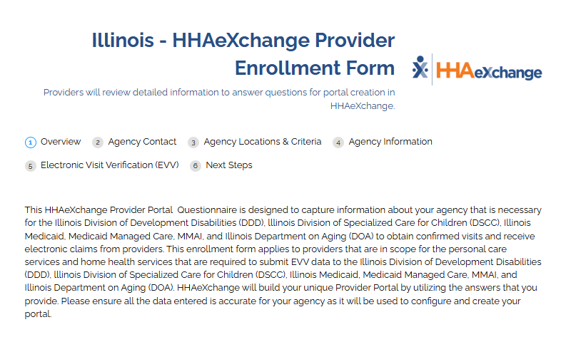
Provider Enrollment
All providers need an HHAeXchange Portal regardless of the system used for EVV
If your agency does not have a portal with HHAeXchange, fill out the survey below
At the time of filling out the survey, you need the following information:
  Agency Identifiers (TIN/NPI)
  Chosen EVV System (either HHAX State Sponsored or Alternate EVV)
  Alternate EVV System contacts
https://www.cognitoforms.com/HHAeXchange1/IllinoisHHAeXchangeProviderEnrollmentForm
Notes:
Colby speak to this

Slide 10
Provider Status in IMPACT
Agencies are automatically linked to program payers once the portal is created
The Illinois Department of Healthcare and Family Services (HFS), the State Medicaid agency, sends HHAeXchange a weekly file with EVV in-scope provider agencies actively enrolled in IMPACT.“
Double Check that your business eligibility in IMPACT is current, any required licenses are current (e.g., Public Health license), revalidation activities have been completed when applicable, and agency identifiers such as Tax Identification Number (TIN) are current. If you require assistance making updates in IMPACT, please reach out to 1-877-782-5565 or IMPACT.Help@illinois.gov
Notes:
Colby speak to this

Slide 11
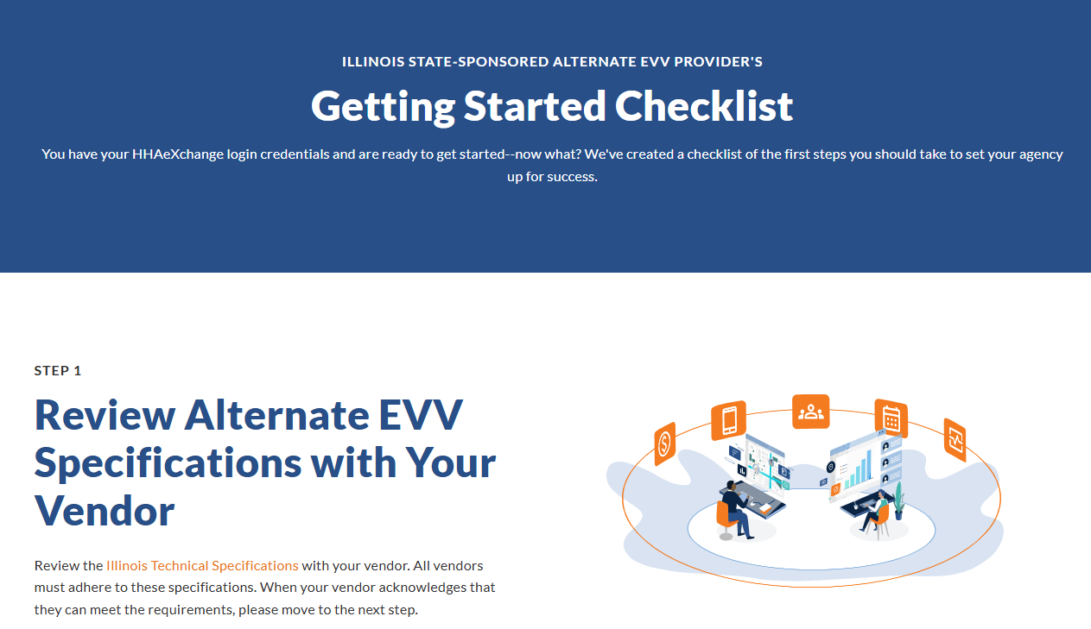
Getting Started Checklist (Alternate EVV)
Once the survey is filled out, use this checklist to complete the integration with HHAX
https://info.hhaexchange.com/getting-started-checklist-illinois-alternate-evv
Notes:
Colby speak to this

Slide 12
EVV:
Roles & Responsibilities

Slide 13
EVV Roles & Responsibilities
Illinois HFS, DDD, and DSCC
Establish EVV Policies and Procedures
Monitor and Enforce EVV Compliance
Policy & Technical Assistance Support
Your Third-Party System
Integrate with HHAeXchange
Support your Agency to import EVV visit data to HHAeXchange (State Aggregator)
Support your Agency in reviewing and managing visit import rejections
Your Agency
Register for an HHAeXchange Portal
Capture EVV for required services
Import EVV visit data to HHAeXchange (State Aggregator)
Review and manage visit import rejections
Review and manage EVV Compliance
HHAeXchange
State Aggregator
Receives member and authorization data from IL Payers
Technical Customer Care Support
Illinois Payers (FFS & MCOs)
Send in-scope members and authorizations (when applicable) to HHAeXchange

Slide 14






EDI Provider
Data Exchange Workflow
Caregiver & Visit Response Status
Success
Failed
HFS sends Member Demographic files to HHAeXchange
Third Party Provider / EVV Vendor
Contains member demographic information; creates member’s record in HHAeXchange
Caregiver Records
Contains authorization data when applicable (date range, units, service code), member ID, provider ID (Tax ID)
Visit Records

Slide 15
Managing Visit
Import Rejections

Slide 16
Visit Import Rejections
Through your Third-Party System’s integration with HHAeXchange, your Agency will submit all required EVV data to the HHAeXchange Aggregator.
Not all visits will import successfully. You will be provided a visit rejection reason for each visit that failed to import to the HHAeXchange Aggregator.
It is your responsibility, with assistance from your Third-Party System and HHAeXchange, to continuously review and resolve visit import rejections.

Slide 17
Reviewing and Resolving Visit Import Rejections
Step One: Regularly review your Agency’s visit import rejections from the HHAeXchange Aggregator.
Step Two: Based on the specific visit import rejection reason, you may need to change certain data points in your visit import. For example, you may need to change the Caregiver or member information in order for the visit to import correctly. You must first work with your Third-Party System on resolving visit import rejections.
Step Three: If you and your Third-Party System cannot resolve a visit import rejection, please submit a Customer Support ticket.
  Provide the Following Information to Submit a Successful Customer Support Ticket:
    Federal Tax ID
    Third-Party System Vendor Name
    External Visit ID / Transaction Id (Format: xxxxxxxx-xxxx-xxxx-xxxx-xxxxxxxxxxxx)

Slide 18
Frequently Asked Questions

Slide 19
Frequently Asked Questions
Q: The Payer has not sent an authorization to my portal; how do I import data?
Authorizations are not required to be in HHAeXchange in order for agencies to import visits.
Ensure the member’s Medicaid ID (RIN) is correct on the import, and HHAeXchange will attempt to pull the member into your portal if it does not already exist there.
Notes:
PRESENTER: Leah
Everything syncs overnight
Link to job aid

Slide 20
Member Management by Contract
Contract | Program | Member Placement Responsibility
Division of Developmental Disabilities | HHCS & PCS (Personal Support Worker) | Provider Agency
Division of Specialized Care for Children | HHCS | Provider Agency
Department of Health & Family Services (State Plan) | HHCS | Provider Agency
IL MCOs | HHCS (when authorization is not required yet) | Provider Agency
IL MCOs | HHCS (when authorization is required) | Payer (MCO) OR Agency
Notes:
Demo Portal: IL Demo in Cloud
Create New Patient
Name: Joseph Smith
DOB: 01/01/1955
Medicaid ID: 33445566
Contract: Demo Payer Cloud
**Auto-placement should work
Create New Patient
Name: Gary Jones
DOB: 01/02/1955
Medicaid ID: 44556678
Contract: Demo Payer Cloud
** Auto-placement should NOT work
Then update Medicaid ID to 44556677 and DOB to 01/01/1955
Go back to contracts page and re-do auto-placement request

Slide 21
Provider Driven Placement
EDI/3rd Party Providers
No Manual Entry Required
Member is automatically created upon visit import from the 3rd Party API
Refer to the Illinois API Technical Specifications for visit import details.
For inquiries or further assistance, please create a support ticket via the Technical Customer Care help desk.
This applies to the following programs:
IDDD Personal Care
State Plan, MCO, DSCC and IDDD Skilled Nursing & Home Health Care Services

Slide 22
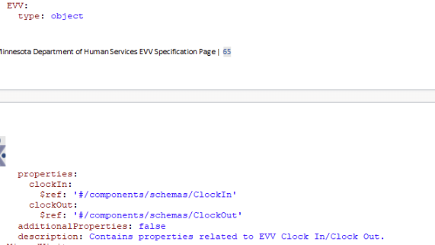
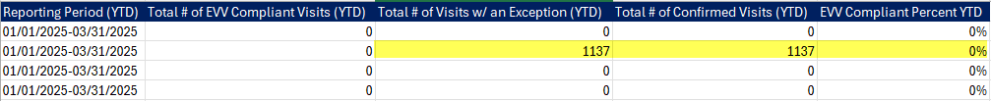
Frequently Asked Questions
Q: Why are all my visits importing with exceptions?
Ensure you are sending the EVV segment of your data
Check to see if you are sending visit edit reason and action codes
Visit confirmation time not corroborating with EVV times
Monthly EVV Compliance % Report
Notes:
PRESENTER: Leah
Everything syncs overnight
Link to job aid

Slide 23
Frequently Asked Questions
Q: Do I need to log into HHAeXchange?
All providers have a portal in HHAeXchange, including EDI Providers.
Most EDI providers are not required to log in, but it is highly recommended to log in on a regular cadence to compare visit data in HHAeXchange versus data in your EVV system.
Logging into HHAeXchange and running reports/reviewing visits ensures accuracy and catches potential issues early.
EDI Providers who requested multiple office locations will need to log in to accept pending placements from payers.
If your agency cannot locate login credentials, please contact Technical Customer Care.
Notes:
PRESENTER: Leah
Everything syncs overnight
Link to job aid

Slide 24
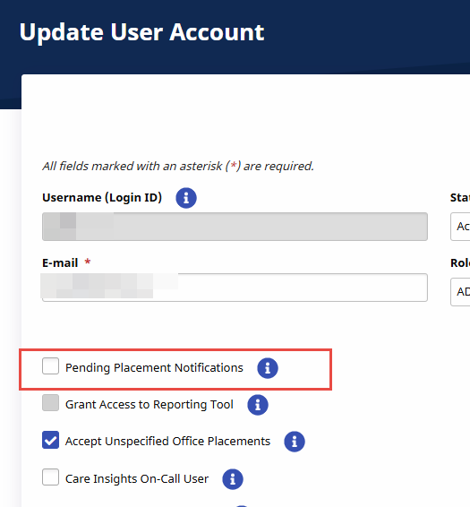
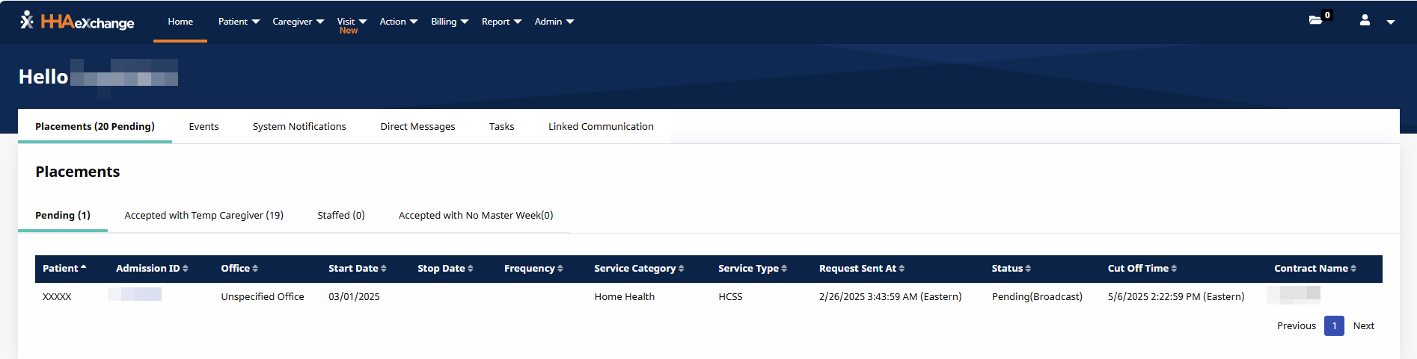
Frequently Asked Questions
Q: What is a Pending Placement, and what should I do with it?
Pending Placements occur when a Provider has more than one office. Authorizations are placed in a Provider’s office based on Tax ID. When a Tax ID is duplicated across 2 or more offices, the authorization will be in Pending status until the Provider manually places the authorization into the correct office.
Steps to Resolve:
  Log into HHAeXchange
  Click the member’s Admission ID
  Select Office you want the authorization to go into
  Select Coordinator
  Click Accept
Notes:
PRESENTER: Leah
Everything syncs overnight
Link to job aid

Slide 25
Frequently Asked Questions
Q: Why is my EVV Compliance % low?
Review your Monthly EVV Compliance % Report:
  Ensure the visits you are importing match what’s on your report (e.g., the number of overall visits match for the time period, the number of EVV compliant visits are correct, etc.)
  Ensure you’re importing visits for all Payers with whom you have census (aka: active clients)
Watch out for these red flags:
  There is no visit data for one or all of your Payer rows
  Your EVV Compliance % is far lower than you would expect for that time period
  Your EVV Compliance is 100% on the report from HHAeXchange, but you know some Caregivers missed clocking in and out that week or month
Notes:
PRESENTER: Leah
Everything syncs overnight
Link to job aid

Slide 26
Common Rejections
& Resolutions

Slide 27
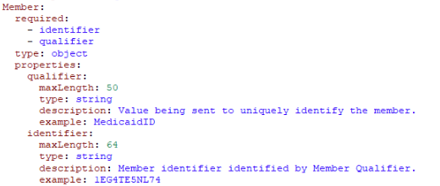
Member Not Found Based on Qualifier Value
Only use the member’s state-issued Recipient Identification Number (RIN), also referred to as Medicaid ID, as the member identifier.
Medicaid ID (RIN) will be a 9-digit value.
012345678

Slide 28
Verifying a Customer’s RIN
Providers can verify member Medicaid eligibility either through one of two methods:
  Check the HFS MEDI system (https://medi.hfs.illinois.gov/IdentityGuardAuth/IdentityGuardLogin.aspx?IGDest=https://medi.hfs.illinois.gov/medi/mlogin.do)
  Call the Participant Eligibility Information Automated Voice Response System (AVRS) at 1-800-842-1461

Slide 29
Visit Date is Not in Range of Eligibility Start and End Date
Log into HHAeXchange to determine if the member has a discharge date assigned (found on the Member’s “Contracts/Payers” page).
If date was added by your agency, but incorrect, adjust it and resubmit the visit(s). If it was not added by your agency, contact Technical Customer Care.

Slide 30
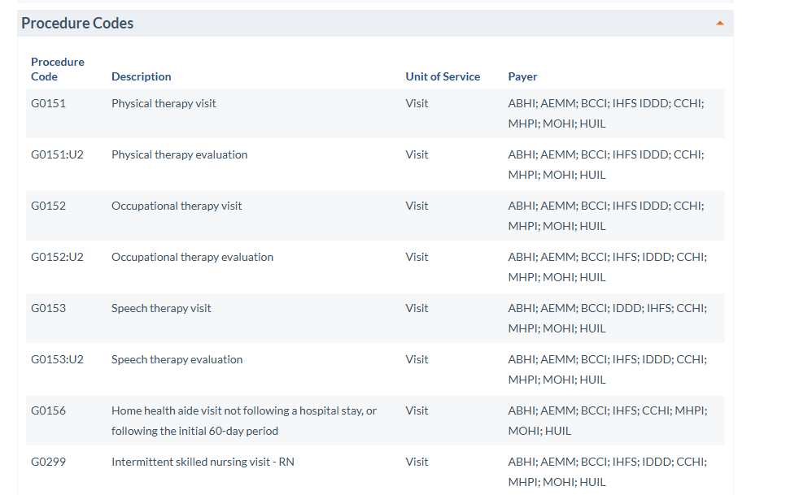
Procedure Code Not Found
Verify the procedure code sent in the API matches a procedure code in the Procedure Code reference table for the appropriate Payer in the specifications.
If procedure codes match, contact Technical Customer Care.
**This is just a portion of the full list. Please reference the specifications for the full list.

Slide 31
EVVMSID is required when sending an update to this visit. Please resend the transaction with the EVVMSID.
For visits which previously loaded successfully, EVVMSID is a unique value assigned to each visit to help HHAeXchange ensure the correct record is modified when updates are transmitted.
Contact your vendor to ensure they populate the EVVMSID field in the API with either the EVVMSID that HHAeXchange returns when a visit is successfully loaded OR the External EVVMSID with a tilde(~) as a prefix.
More information can be found on the specifications under the “Electronic Visit Verification (EVV) Information” section.

Slide 32
Can Occur if there is an Interruption in Service
Generally, this error occurs when there is an interruption with the API service or if the agency exceeds more than 5 calls per second (transmission limit).
Vendor should re-send the data, and if the issue does not resolve itself, contact Technical Customer Care.

Slide 33
Resources

Slide 34
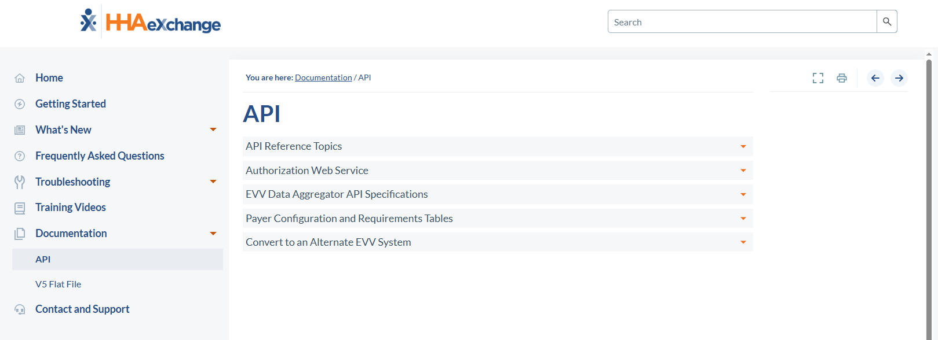
HHAeXchange Knowledge Base (API)
https://knowledge.hhaexchange.com/EDI/Content/Documentation/EDI/API.htm

Slide 35
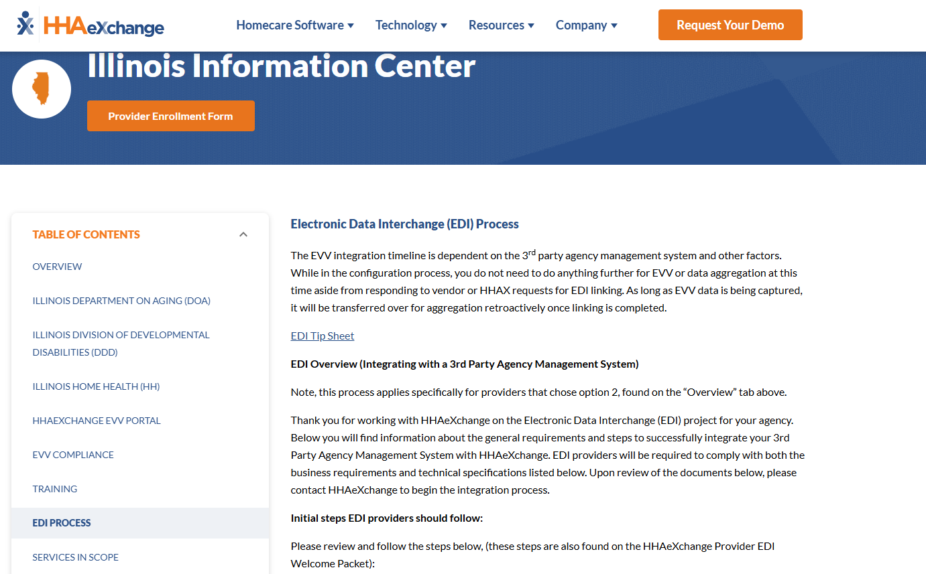
State Info Hub (EDI Process)
https://hhaexchange.com/info-hub/illinois

Slide 36




HHAeXchange Support
Illinois Support
State Info Hub
https://hhaexchange.com/info-hub/illinois
HFS Email
HFS.EVV@illinois.gov
Client Support Portal
https://hhaexchange.my.site.com/s/login/
DSCC Email
O365-dscc-evv@uic365.onmicrosoft.com
Email
ILSupport@hhaexchange.com
DDD Email
dhs.dddevv@illinois.gov
Phone
1-646-821-8784
Provider Resources
Notes:
Provider Resources:
We want to make sure you are aware of the resources available to you as a provider.
HHAeXchange Support:
If you have any specific questions that you need assistance with, you can reach out to our HHAeXchange support team by utilizing the client support portal, sending us an e-mail or by calling us at the number provided. To access the client support portal, simply click on the "Support Center" option located at the top right corner of your HHAeXchange portal. Within the support portal, you'll find various channels through which you can reach out to our support team and conveniently manage all your tickets in a centralized location.
Illinois Home Health Support:
For any questions directed to Illinois Home Health, please make sure to utilize the two emails provided on this slide.
Conclusion:
That brings us to the end of our webinar. We would like to thank everyone for joining us today and hope that you found this information helpful for our Go Live. If you have all your questions answered, you are welcome to leave the webinar. If you still have questions, please use the Q&A button at the bottom of your screen to ask them. We have a team of panelists here to help answer those questions. We will keep the webinar running until we have responded to everyone.

Slide 37
Q&A

Slide 38
Thank You!

